Slide 1


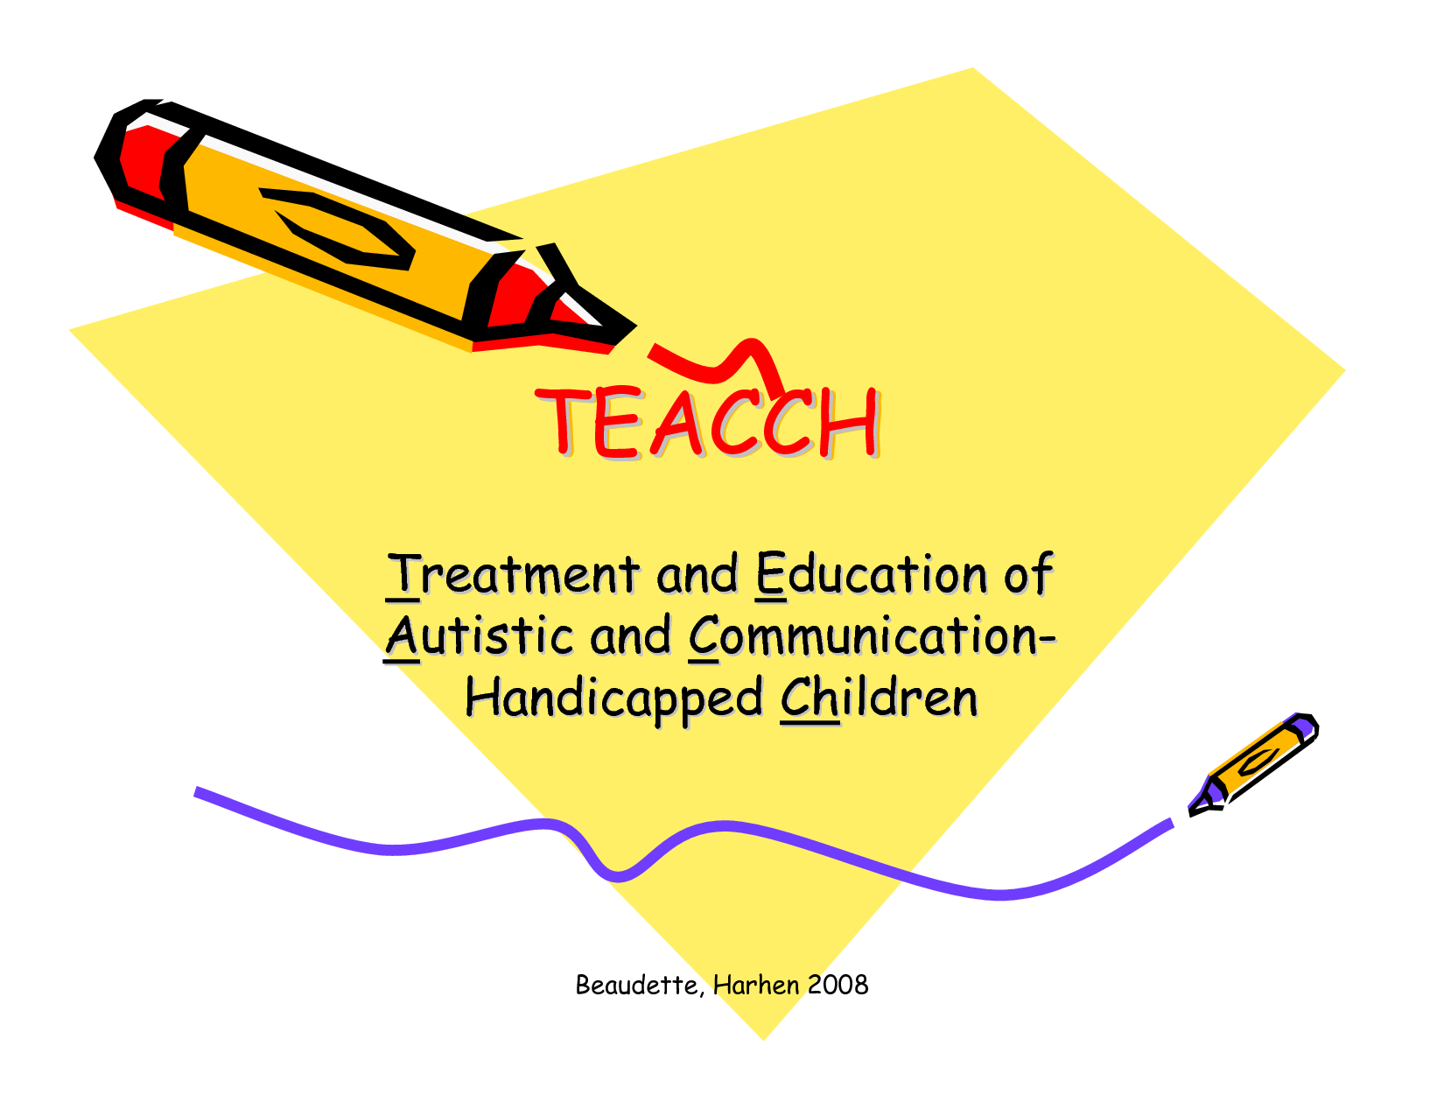

Slide 2

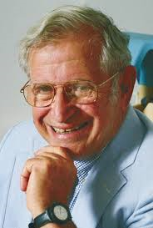
Background
Founder of TEACCH, Eric Shopler (1970s)
Settings: Home/ Residential/ Specialist & Mainstream
Notes:
A multi-national survey completed by 552 parents of children with ASC suggested that 30% of families currently use, or had used, the TEACCH programme (Green et al., 2006). Although 80% of respondents in this study were from America, the remaining 20% of participants were recruited worldwide.
TEACCH is one of the most ﬁrmly established, visible and frequently cited autism programmes worldwide (Gresham, Beebe-Frankenberger, & MacMillan, 1999).

Slide 3
TEACCH Principles
TEACCH was specifically designed for children with ASC.
TEACCH FUNDAMENTAL PRINCIPLES
It is an individualised education programme. | A structured teaching system is used. | There is close collaboration between parents and professionals.
Notes:
TEACCH is, therefore, a global approach which aims to modify the environment in order to meet the specific needs of each young people with the condition (Schopler, 1997).

Slide 4

Individualised education programme.
Assessments are used to create an individualised treatment programme which meets the specific needs of every child, young person or adult.
But is this inclusive?
Notes:
The three fundamental, guiding principles of TEACCH will now be explored, in relation to underlying psychological theory, debates and research.
Not inclusive - This is because TEACCH is based on the assumption that students with ASC are not responsive to ‘typical’ education in regular classroom settings and require a more specialised, structured education programme (Panerai et al., 2009). This approach has often manifested in children with ASC being educated in classroom settings, apart from their ‘typically developing’ peers.
Is inclusive: However, a non-inclusive approach is not stipulated by TEACCH researchers. They have argued that schools should find specific solutions to integrate children with ASC into whole-class settings (Panerai, Ferrante, & Zingale, 2002). The appropriate conditions are, however, needed for development, learning and integration. Schools needs to ask, ‘how can we change to meet this child’s needs and promote their learning’, as opposed to, ‘how does the child need to change to fit into the school system’. Changing the environment to suit the child’s needs, rather than changing the individual, is part of a holistic ‘whole-child’ as opposed to a ‘within-child’ approach. Therefore, the argument that TEACCH is non-inclusive detracts from the responsibility of schools to adapt their learning environment according to the needs of every child.

Slide 5
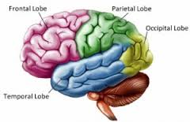
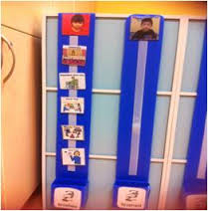


Structured teaching.
Structured teaching involves:
Structured Teaching
Notes:
Physical organisation/ visual schedules/ special interest
Structure: an appreciation of how children with autism interact with the environment and beneﬁt from structured and predictable presentation of stimuli and events. Bodfish’s (2004) analysis of the literature suggested a structured environment can aid independence by reducing dependence on other people. A modified environment ensures that individuals with ASC knows what is going to happen next and what is expected of them. This can help develop a sense of autonomy and competence.
Visual - Visual cues are often used to help structure the environment and teach a communication system based on gesture, pictures, signs, or printed words. A well-established ASC characteristic is a preference for processing visual, as opposed to auditory, information. Excessive language processing can cause confusion and distress, whereas visual information can alleviate these difficulties. There is robust neurological research to support these findings. A meta-analysis, conducted by Samson et al. (2012) analysed and synthesised 26 brain imaging studies, worldwide. It was found that people with ASC concentrate more brain resources in the temporal and occipital regions of the brain; areas associated with visual detection and identification (Quill, 1997). In contrast, there is less activity in the frontal cortex, an area used to plan, control and execute thoughts and actions – FIRST evidence that that enhanced visual-perceptual processing is a core feature of neural organisation in the ASC
Intense, and often atypical, interests are common characteristics of ASC according to the DSM–IV (American Psychiatric Association, 1994). In evidence of this, Boyd et al. (2007) observed that children’s social interactions increased when play materials were adapted to their own special interests, Charlop-Christy and Haymes (1998) also found that there was a reduction in tantrums and aggression when preferred play objects were chosen to reinforce good behaviour, as opposed to arbitrarily chosen stimuli.
Using the special interests of a child with ASC to motivate them is a person-centred approach to learning. Person centred planning (PCP) elicits a child’s individual perspective on what is important and relevant to them (Murray & Sanderson, 2007). Giving young people choice about how they study puts them at the centre of their planning. An example of this could be to use Thomas the Tank Engine pictures to teach pre-academic skills. According to Sanderson (2000) this is an empowering and collaborative approach to learning which embraces the humanistic principles of choice and growth.

Slide 6

Collaborative approach
Schopler (2005), ascribed to a ‘holistic orientation’ whereby parents are given the role of co-therapist.
Notes:
generalise what they have learnt at school into other contexts
Coordination between home and school provides children with more consistent treatment and increased opportunities to practice communication, socialisation and daily living skills = natural part of their day-to-day life.
Beneficial to parents themselves, as well as their children. A study by Bristol, Gallagher and Holt (1993) compared self-reported symptoms of depression in two groups of mothers who had pre-school children with ASC. One group received the TEACCH programme and the other acted as the control group. The mothers who received the TEACCH intervention reported significantly less depressive symptoms than the mothers in the control group, between baseline and 18 months.
Parental self-efficacy in the experimental group protected them from depressive symptoms. Teti and Gelfand (1991) have described parental self-efficacy as the degree to which adults perceive themselves as capable and effective in the parenting role. Low parental self-efficacy has been linked to passive coping methods, low levels of perseverance and mood, whereas higher self-efficacy has been related to feelings of empowerment and control.

Slide 7
Empirical Evidence and Evaluation
A substantial body of evidence has been collated.
Variation exists according to the assessment methods used; the target population selected; the duration and intensity of the programme; and which aspects of the intervention are measured.
Virues-Ortega et al. (2013) believe that such variability, ‘precludes a straightforward appreciation of the treatment effectiveness’ (p. 941).

Slide 8
Preliminary Meta-Analysis (Virues-Ortega et al.,2013)
220 distinct studies
13 studies remained
Findings
Negligible effect | Adaptive behaviour repertoires i.e. communication and self-help skills
Small effect | Perceptual, motor, verbal and cognitive skills
Moderate to large gains | Social and maladaptive behaviours
Overall | Moderate
Notes:
This focused on three age ranges: five years or less; six to 17 years and 18 years and above.
Over half the original studies had not been peer reviewed and many had small sample sizes and lacked treatment fidelity.
Adults most benefit

Slide 9
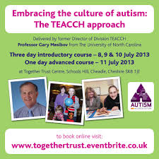
Problems with meta-analysis.
TEACCH is a well-established ‘brand’ or ‘package’ - there is a difficulty in separately analysing the individual components which make up the programme.
Kazdin (2008) added that even, ‘a statistically significant change on a standard, popular, valid and useful measure may not tell us how a patient is doing in the world’ (p.148).
Cultural applications/ Across setting
Notes:
This is one of the most significant limitations in the TEACCH research.
There are calls for more research to be conducted to explore the efficacy of these specific components and how they impact on key outcome factors (Mesibov & Shea, 2010).
Meta-analyses also do not account for qualitative studies or mechanisms or moderators of change.

Slide 10


Causal-comparative research
VS
Maurice, Green and Luce (1996) have called for an end to the ‘ferocious ideological warfare’ which has dominated the autism world (p. 6).
They have entreated researchers to explore the common factors which underlie successful interventions.
Danger of an eclectic approach.
Notes:
visible and widely cited autism intervention models. A large body of research has viewed them as being mutually exclusive of one another, according to their different conceptual frameworks (Eikeseth, 2009; Probst et al. 2010). However, some researchers have examined the common features of both programmes (Boyd et al., 2014; Callahan, Shukla-Mehta, Magee & Wie, 2010).
Boyd et al. (2014) compared the efficacy of an ABA programme known as LEAP (Learning Experience and Alternative Program for Pre-schoolers and their Parents), to a Non-Model Specific Education Programme and TEACCH. They found that children reduced their ASC characteristics over time, irrespective of programme type. Boyd et al. (2014) argued that perhaps it is the not unique features of the model, but rather the common features, such as classroom organisation and instructional climate, which influence positive outcomes. This study supported Callahan et al.’s (2010) research which concluded that parents and educational professionals showed no clear preference for either programme.
improve the efficacy of the programmes, rather than competing against one another. However, this is not to say that practitioners use an eclectic approach, and select the ‘best bits’ from various ASC interventions. It is important that a well-established programme is followed for which there has been systematic planning and research.

Slide 11

Summary: Implications for Educational Psychologists and Wider Application
When choosing an ASC intervention consider the following (Francis, 2005):
Theoretical Rationale
Empirical Evidence
Possible negative effects
Impact on family/ school
Notes:
At present, no single ASC intervention or approach has been deemed to be the most efﬁcacious, based on methodologically robust studies (Francis, 2005). This leaves parents and educational professionals with a difficult decision as to which programme to choose for their child. Educational Psychologists (EPs) are well placed to provide advice about the range of ASC treatment options available.
The TEACCH programme has been specifically designed for children with ASC, and its guiding principles are supported by theoretical, and some empirical, research. The programme helps to minimise a child’s difficulties by employing a structured and continuous intervention over time. This involves environmental adaptations and a collaborative approach with parents. These approaches are based on the integrated use of behaviour and cognitive theory,
Inclusive debate??? Should be to be interactionist, ‘whole-child’ approach to intervention, rather than focusing on ‘within-child’ factors. Applying TEACCH in natural settings, with the parent acting as a co-therapist, is also economical and ensures a more holistic treatment approach.
Probst et al. (2010) has argued that the internal validity of the programme is moderately limited. It has been argued that TEACCH has not effectively communicated research-based answers to consumers. Too few studies have explored how and why speciﬁc components of the models work, in which contexts, and with which population (Callahan et al., 2010). EPs are in a position to call for, and indeed conduct, more research which identifies and systematically evaluates individual components of the programme. Causal-comparative research should also be conducted in order to identify the most effective common features of different programmes. This would benefit the ASC research community, as a whole, as well as ensuring that TEACCH continues to develop and improve.

Slide 12
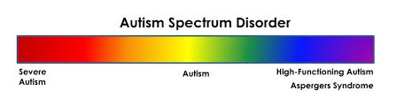
Concluding thoughts…
Mesibov & Shea (2010)
What is neat is not always best
Notes:
There can be no tight manual which prescribes a standardised treatment programme to every child, given that autism is a spectrum condition. Limits replicability.

